Slide 1
Countable and uncountable nouns
home

Slide 2
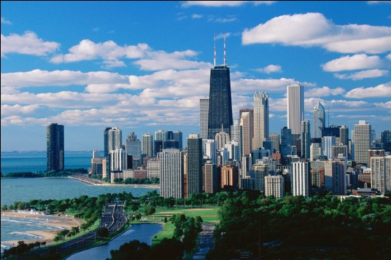
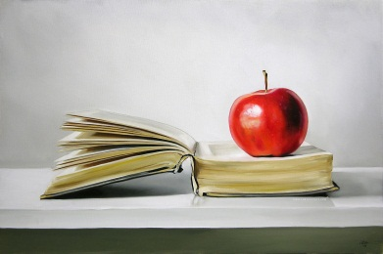
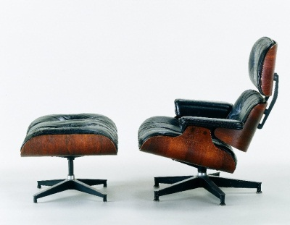
Nouns
A noun is
a person,
a place,
a thing,
or an idea.

Slide 3
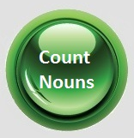
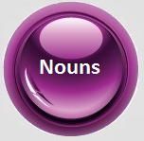
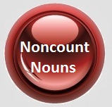

Slide 4
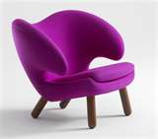
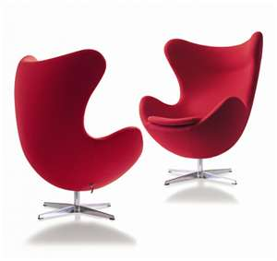
Countable and UNCOUNTABLE nouns
There are two kinds of nouns in English.
Countable Nouns
are nouns that you can count.
one chair
two chairs
Uncountable
Nouns
are
i. nouns that you cannot count
ii. inseparable
iii. of the same kind : furniture, luggage
iV. abstract ideas: happiness, permission

Slide 5
Countable Nouns
Uncountable Nouns.
are nouns that you can count.
They are used with ‘a’, ‘an’ or numbers or quantifiers.
i. nouns that you cannot count
ii. inseparable
iii. of the same kind : furniture, luggage
iV. abstract ideas: happiness, permission
They are used with ‘ the’ and quantifiers as ‘some’, ‘much’, etc.
Ex1 &2 Page40,41

Slide 6
Countable Nouns
How do you make a singular countable plural?
Regular changes
Irregular changes

Slide 7
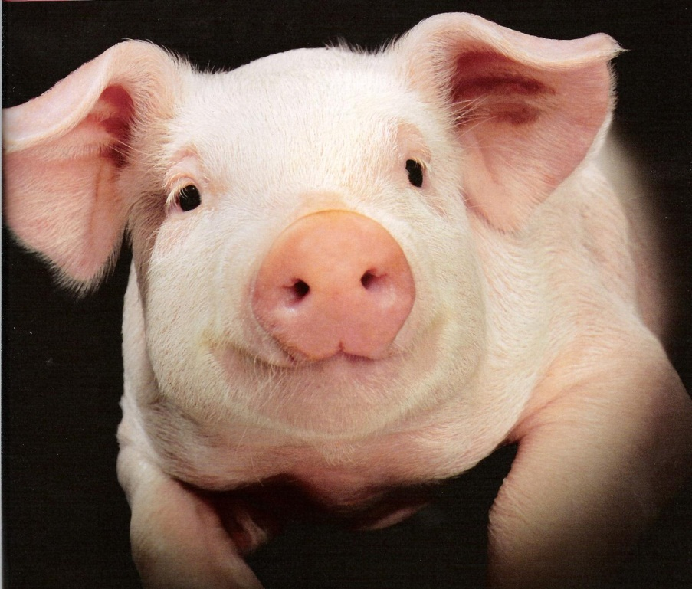
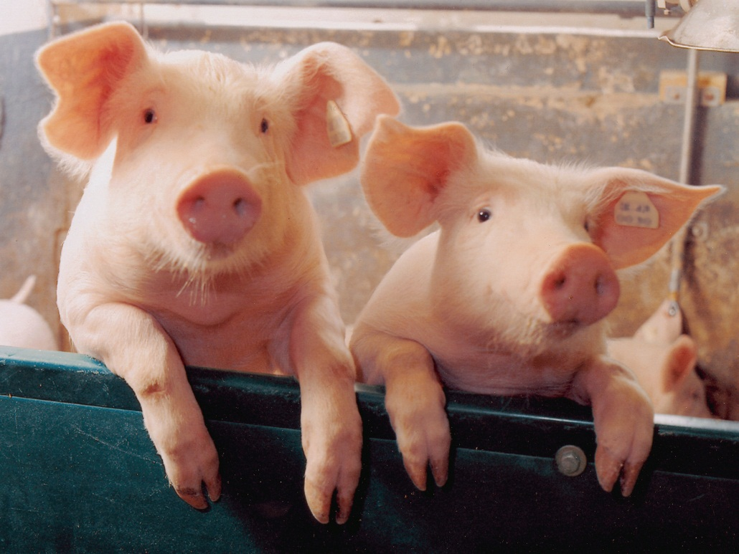
Regular change
one pig
two
pigs
For nouns that end with a consonant, add s.

Slide 8
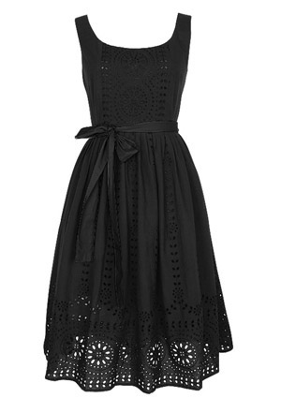
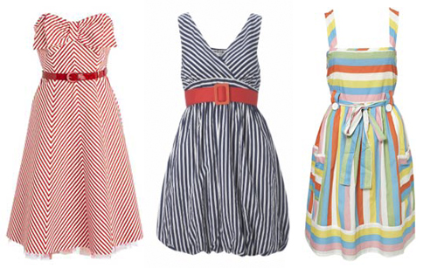
Regular change
one dress
three
dresses
For nouns that end in sh, ch, x, s, z, add es.

Slide 9
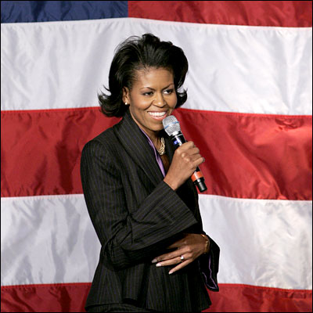
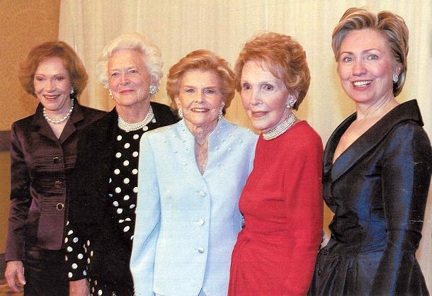
Regular change
one first lady
five
first ladies
For nouns that end in a consonant and y, the y becomes ies.

Slide 10
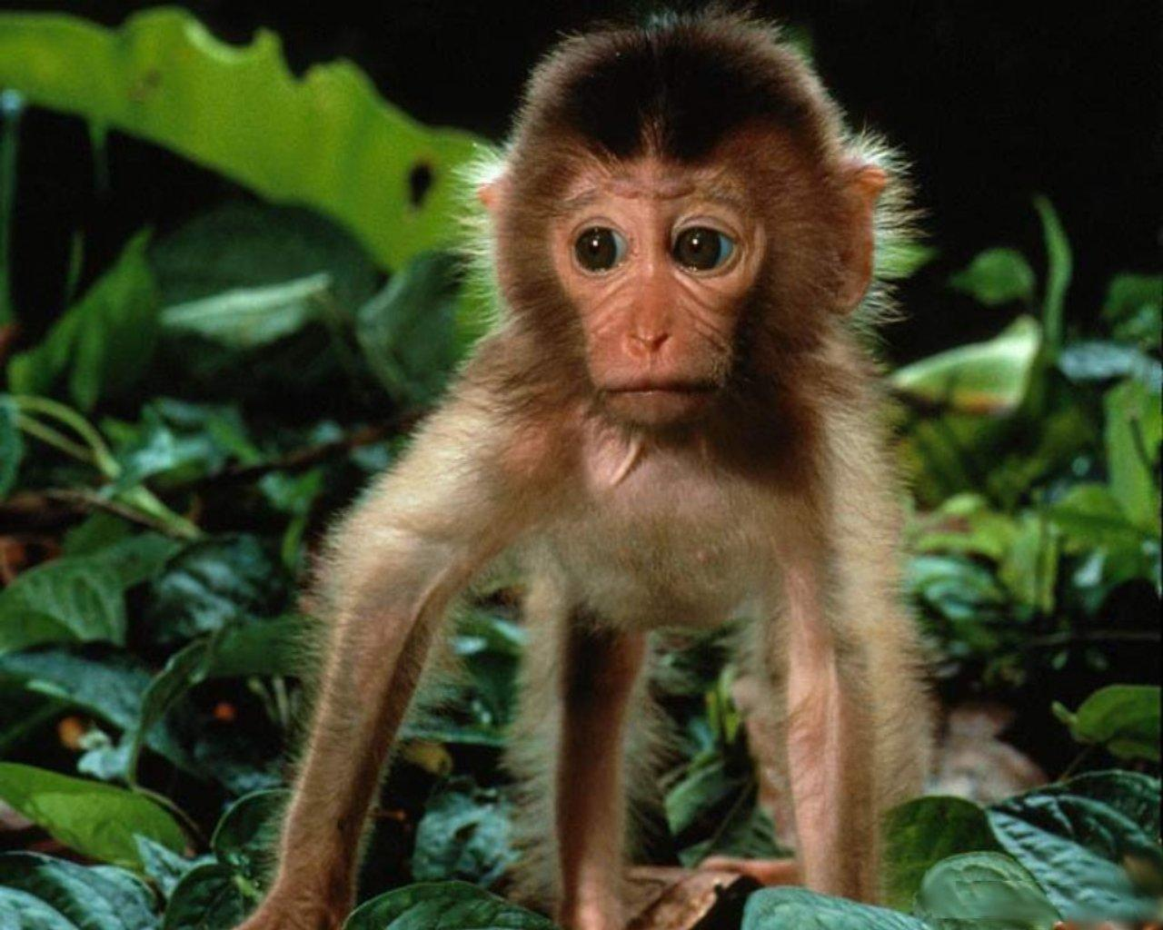
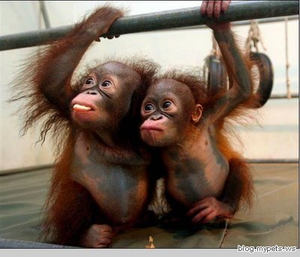
Regular change
one monkey
two
monkeys
For nouns that end with a vowel and y, add s.

Slide 11
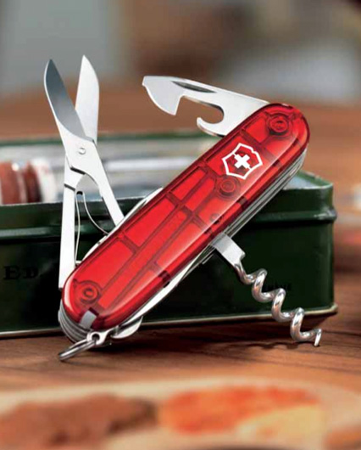
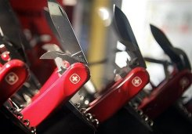
Regular change
one knife
three
knives
For nouns that end in fe or f, change the fe and f to v and add es.

Slide 12
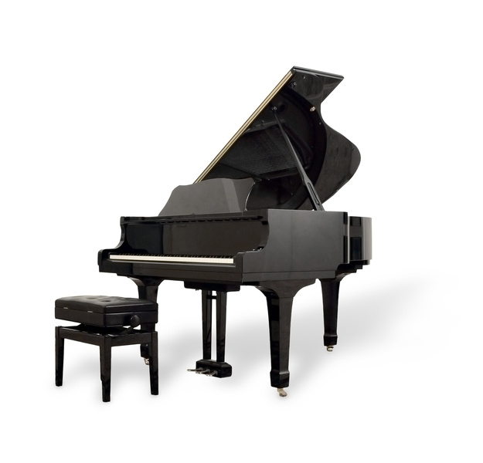
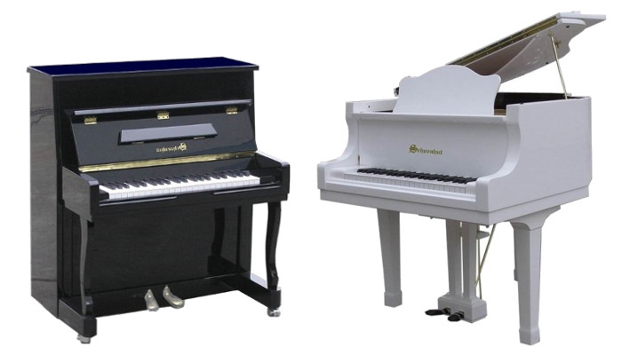
Regular change
one piano
two
pianos
For most nouns that end in o, add s.
(See the next slide for exceptions.)

Slide 13
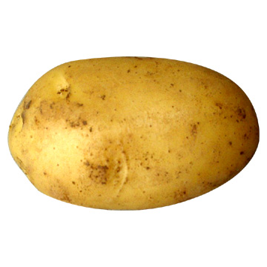
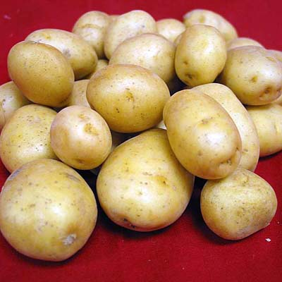
Regular change
one potato
a lot of
potatoes
For some nouns that end in o, add es.

Slide 14
Regular change
7.end in IS，change IS into ES
analysis—analyses basis—bases crisis—crises
8. end in us， change us into I
fungus—fungi cestus--cesti
9. end in um， change um into a
datum—data stadium--stadia

Slide 15
Regular change
10.end in a，add e
formula—formulae hydra—hydrae
11.end in ix ，change ix into ices
esmatrix—matrices directrix—directrices

Slide 16
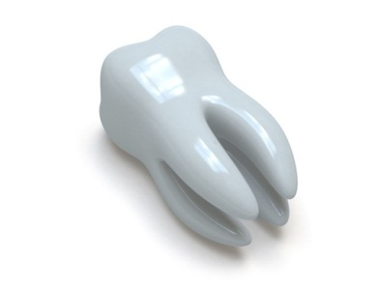
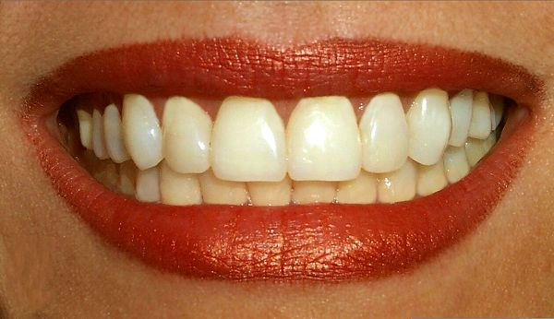
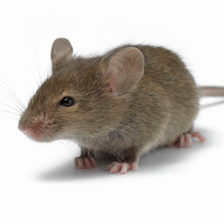
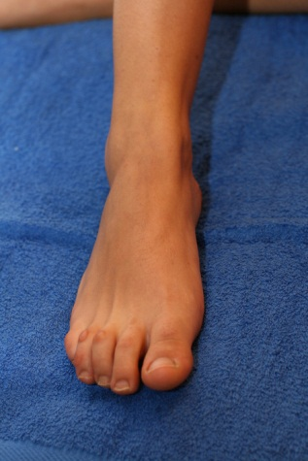
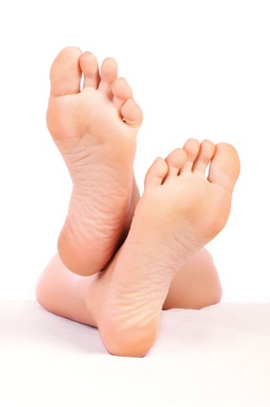
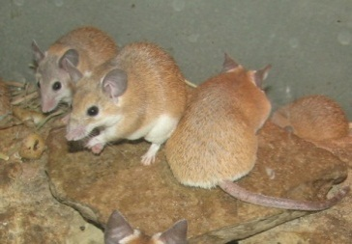
Irregular Change
How do you make a singular count noun plural?
Some nouns have an irregular plural.
teeth
mouse
tooth
feet
mice
foot

Slide 17
Irregular change
1. Some nouns change their vowels in the
middle of the singular form
(1) man---men
all the words that contains ‘man’
Policeman----policemen
（2） oo-ee
foot—feet tooth—teeth goose—geese
（3）add en
child—children ox—oxen

Slide 18
2. Nouns with the same singular and plural form
(1)animals
deer reindeer cod salmon fish
（2）compound words with craft
craft aircraft spacecraft
（3）nationalities
Chinese Japanese Swiss
（4）others
species means news

Slide 19
（5）special cases
A） hair
Go and get your hair cut.
&
He had a few white hairs.
B）fruit
Apples , oranges and bananas are fruit.
&
The most common fruits there are pear , apple and peach.
C）fish
I caught a fish(two fish).
&
We’ll go and look at the fishes in the aquarium.

Slide 20
3. Compound Nouns
adding -s to the "base word" (the most "significant" word.
singular | plural
a tennis shoe | three tennis shoes
one assistant headmaster | five assistant headmasters
a mother-in-law | two mothers-in-law
an assistant secretary of state | three assistant secretaries of state
my toothbrush | our toothbrushes
a woman-doctor | four women-doctors
a doctor of philosophy | two doctors of philosophy
a passerby, a passer-by | two passersby, two passers-by

Slide 21
Plural Forms of Compound Nouns
If there is no “significant ” word, we usually add s at the end.
singular | plural
Grow-up | Grow-ups
Stand-by | Stand-bys

Slide 22
4.Nouns only used in plural.
（1）Pair nouns
jeans(牛仔褲)、headphones(耳機)、trousers(褲子)、clothes (衣服)、pants(短褲)、glasses(眼鏡)、shoes (鞋子)、sunglasses(太陽鏡)、scissors (剪刀)、compasses(圓規)。
If you want to refer to the number, use a/one pair of …
I have bought a pair of jeans.
I have bought two pairs of jeans.
（2）some foods
noodles、 vegetables、snacks
（3） fixed phrases.
a letter of thanks
in high/low spirits
have sports

Slide 23
（4）news , means
By all _______,you must try every _______ to help him. A.mean,mean B.means,means
C.means,mean D.mean,means
（5）some proper nouns
the United States; the United Nations;
the United Kingdoms; the Arabian Nights ;
（6）congratulations.

Slide 24
5. Some words that end with s
（1）disease
diabetes
（2）subject
physics economics maths politics
（3）activities.
cards athletics
Ex 2&3 on Page 41,42

Slide 25
6. Numeric Adjective
a score' ( = 20, in Old English),
a dozen' ( = 12 ),
a 'hundred' ( = 100 ),
a 'thousand' ( = 1,000 ),
a 'million' ( = 1,000,000 )

Slide 26
6.DOZEN/SCORE/HUNDRED/THOUSAND
they always remain in the singular and followed by a noun
They must be in the plural, when they are followed by 'of '
six dozen pencils
two score years
Two hundred old people
dozens of eggs
scores of trees
hundreds of miles

Slide 27
7.Compound adjective
I have a two-year-old dog.
He wrote a three-thousand-word composition.
That is an eight-day clock.
That is a three-foot-high table.

Slide 28
8.Collective nouns.
（1）It can be used as either singular or plural, according to whether the word is perceived as a unit or as individual items.
His family is large.
His family are all waiting for him.
This class consists of 45 pupils.
This class are reading English now.

